Slide 1
Lecture - 12 on
Data Structures and Algorithms

Slide 2
All-Pairs Shortest Paths
Given:
  Directed graph G = (V, E)
  Weight function w : E → R
Compute:
  The shortest paths between all pairs of vertices in a graph
  Representation of the result: an n × n matrix of shortest-path distances δ(u, v)
2
3
4
1
8
3
2
-4
1
-5
7
5
4
6

Slide 3
The Floyd-Warshall Algorithm
Given:
  Directed, weighted graph G = (V, E)
  Negative-weight edges may be present
  No negative-weight cycles could be present in the graph
Compute:
  The shortest paths between all pairs of vertices in a graph
2
3
4
1
8
3
2
-4
1
-5
7
5
4
6

Slide 4
The Structure of a Shortest Path
Vertices in G are given by V = {1, 2, …, n}
Consider a path p = ⟨v₁, v₂, …, v_{l}⟩
  An intermediate vertex of p is any vertex in the set {v₂, v₃, …, v_{l-1}}
  E.g.: p = ⟨1, 2, 4, 5⟩: {2, 4}
  p = ⟨2, 4, 5⟩: {4}
3
6
0.5
1
2
3
4
2
1
2
5

Slide 5
The Structure of a Shortest Path
For any pair of vertices i, j ∈ V, consider all paths from i to j whose intermediate vertices are all drawn from a subset {1, 2, …, k}
  Find p, a minimum-weight path from these paths
p₁
i
p_{u}
j
p_{t}
No vertex on these paths has index > k

Slide 6
Example
d_{ij}^{(k)} = the weight of a shortest path from vertex i to vertex j with all intermediary vertices drawn from {1, 2, …, k}
d₁₃⁽⁰⁾ =
d₁₃⁽¹⁾ =
d₁₃⁽²⁾ =
d₁₃⁽³⁾ =
d₁₃⁽⁴⁾ =
6
6
3
6
0.5
1
2
5
3
4
2
1
5
4.5

Slide 7
The Floyd-Warshall algorithm
Floyd-Warshall(W[1..n][1..n])
01 D ← W // D⁽⁰⁾
02 for k ← 1 to n do // compute D^{(k)}
03 for i ←1 to n do
04 for j ←1 to n do
05 if D[i][k] + D[k][j] < D[i][j] then
06 D[i][j] ← D[i][k] + D[k][j]
07 return D
Running Time: O(n³)

Slide 8
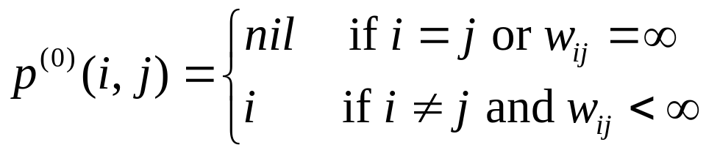
Computing predecessor matrix
How do we compute the predecessor matrix?
  Initialization:
  Updating: p^{(k)}(i,j) = p^{(k-1)}(i,j) if(d^{(k-1)}(i,j)<=d^{(k-1)}(i,k)+(d^{(k-1)}(k,j)
  p^{(k-1)}(k,j) if(d^{(k-1)}(i,j) > d^{(k-1)}(i,k)+(d^{(k-1)}(k,j)

Slide 9
Computing predecessor matrix
Floyd-Warshall(W[1..n][1..n])
01 …
02 for k ← 1 to n do // compute D^{(k)}
03 for i ←1 to n do
04 for i ←1 to n do
05 if D[i][k] + D[k][j] < D[i][j] then
06 D[i][j] ← D[i][k] + D[k][j]
07 P[i][j] ← P[k][j]
08 return D

Slide 10
Example
d_{ij}^{(k)} = min {d_{ij}^{(k-1)} , d_{ik}^{(k-1)} + d_{kj}^{(k-1)} }
D⁽⁰⁾ = W
D⁽¹⁾
2
1
2
3
4
5
1
2
3
4
5
3
4
1
0 | 3 | 8 | ∞ | -4
∞ | 0 | ∞ | 1 | 7
∞ | 4 | 0 | ∞ | ∞
2 | ∞ | -5 | 0 | ∞
∞ | ∞ | ∞ | 6 | 0
1
0
3
8
∞
-4
1
8
3
2
2
∞
0
∞
1
7
2
1
3
3
∞
4
0
∞
∞
-4
7
-5
5
4
4
4
2
5
-5
0
-2
6
5
5
∞
∞
∞
6
0
D⁽²⁾
1
2
3
4
5
D⁽³⁾
D⁽⁴⁾
1
0
3
8
4
-4
0
3
8
4
-4
0
3
-1
4
-4
2
∞
0
∞
1
7
∞
0
∞
1
7
3
0
-4
1
-1
3
∞
4
0
5
11
∞
4
0
5
11
7
4
0
5
3
4
2
5
-5
0
-2
2
-1
-5
0
-2
2
-1
-5
0
-2
5
∞
∞
∞
6
0
∞
∞
∞
6
0
8
5
1
6
0

Slide 11
Example
d_{ij}^{(k)} = min {d_{ij}^{(k-1)} , d_{ik}^{(k-1)} + d_{kj}^{(k-1)} }
D⁽⁵⁾
P⁽⁵⁾
2
1
2
3
4
5
1
2
3
4
5
3
4
1
0 | 1 | -3 | 2 | -4
3 | 0 | -4 | 1 | -1
7 | 4 | 0 | 5 | 3
2 | -1 | -5 | 0 | -2
8 | 5 | 1 | 6 | 0
1
-
3
4
5
1
1
8
3
2
2
4
-
4
2
1
2
1
3
3
4
3
-
2
1
-4
7
-5
5
4
4
4
4
3
4
-
1
6
5
5
4
3
4
5
-
Source: 5, Destination: 1
Shortest path: 8
Path: 5 …1 : 5…4…1: 5->4…1: 5->4->1
Source: 1, Destination: 3
Shortest path: -3
Path: 1 …3 : 1…4…3: 1…5…4…3: 1->5->4->3

Slide 12
Problem: Laying Telephone Wire
Central office

Slide 13
Wiring: Naïve Approach
Central office
Expensive!

Slide 14
Wiring: Better Approach
Central office
Minimize the total length of wire connecting the customers

Slide 15
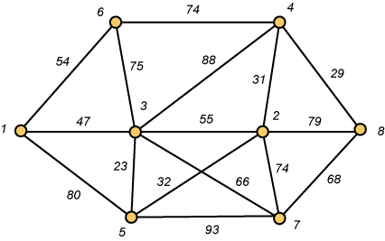
A Networking Problem
Problem: The vertices represent 8 regional data centers which need to be connected with high-speed data lines. Feasibility studies show that the links illustrated above are possible, and the cost in millions of dollars is shown next to the link. Which links should be constructed to enable full communication (with relays allowed) and keep the total cost minimal.

Slide 16
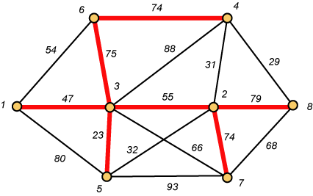
Links Will Form a Spanning Tree
Cost (T) = 47 + 23 + 75 + 74 + 55 + 74 + 79
= 427

Slide 17
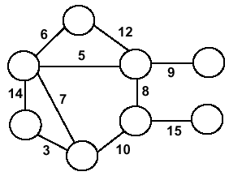
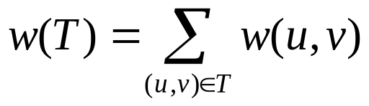
Minimum Spanning Trees
Undirected, connected graph G = (V,E)
Weight function W: E → R (assigning cost or length or other values to edges)
Spanning tree: tree that connects all the vertices (above?)
Minimum spanning tree: tree that connects all the vertices and minimizes

Slide 18
Minimum Spanning Tree (MST)
A minimum spanning tree is a subgraph of an undirected weighted graph G, such that
it is a tree (i.e., it is acyclic)
it covers all the vertices V
  contains |V| - 1 edges
the total cost associated with tree edges is the minimum among all possible spanning trees
not necessarily unique

Slide 19
How Can We Generate a MST?
9
b
9
b
a
2
6
a
2
6
d
d
4
5
4
5
5
4
5
4
5
e
5
e
c
c

Slide 20
Greedy Choice
We will show two ways to build a minimum spanning tree.
A MST can be grown from the current spanning tree by adding the nearest vertex and the edge connecting the nearest vertex to the MST. (Prim's algorithm)
A MST can be grown from a forest of spanning trees by adding the smallest edge connecting two spanning trees. (Kruskal's algorithm)

Slide 21
Notation
Tree-vertices: in the tree constructed so far
Non-tree vertices: rest of vertices
Prim’s Selection rule
Select the minimum weight edge between a tree-node and a non-tree node and add to the tree

Slide 22
The Prim algorithm Main Idea
Select a vertex to be a tree-node
while (there are non-tree vertices) {
if there is no edge connecting a tree node with a non-tree node
return “no spanning tree”
select an edge of minimum weight between a tree node and a non-tree node
add the selected edge and its new vertex to the tree
}
return tree
6
a
4
b
5
u
14
2
10
c
v
3
8
15
d
f

Slide 23
Prim’s Algorithm
Vertex based algorithm
Grows one tree T, one vertex at a time

Slide 24
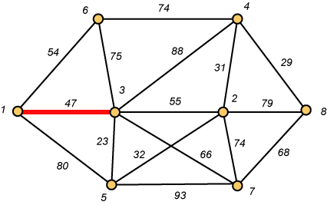
Prim – Step 1

Slide 25
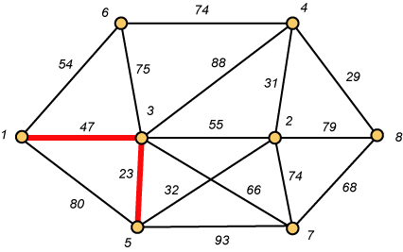
Prim – Step 2

Slide 26
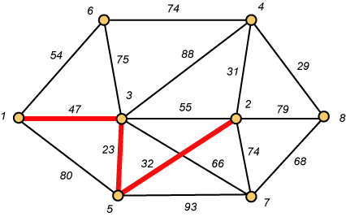
Prim – Step 3

Slide 27
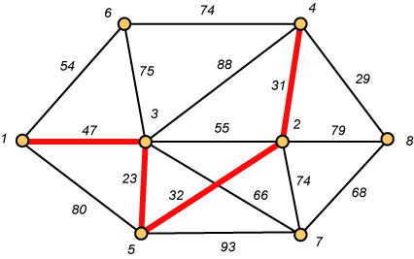
Prim – Step 4

Slide 28
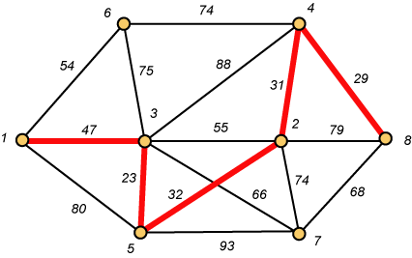
Prim – Step 5

Slide 29
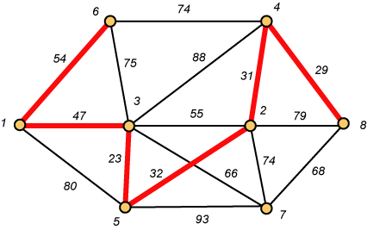
Prim – Step 6

Slide 30
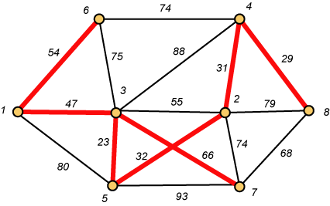
Prim – Step 7 Done!!
Weight (T) = 23 + 29 + 31 + 32 + 47 + 54 + 66 = 282

Slide 31
Prim Algorithm (2)
MST-Prim(G,w,r)
01 Q ← V[G] // Q – vertices out of T
02 for each u ∈ Q
03 key[u] ← ∞
04 key[r] ← 0 // r is the first tree node, let r=1
05 π[r] ← NIL
06 while Q ≠ ∅ do
07 u ← ExtractMin(Q) // making u part of T
08 for each v ∈ Adj[u] do
09 if v ∈ Q and w(u,v) < key[v] then
10 π[v] ← u
11 key[v] ← w(u,v)

Slide 32
Prim Algorithm:Variables
r:
  Grow the minimum spanning tree from the root vertex “r”.
Q:
  is a priority queue, holding all vertices that are not in the tree now.
key[v]:
  is the minimum weight of any edge connecting v to a vertex in the tree.
π [v]:
  names the parent of v in the tree.
T[v] –
  Vertex v is already included in MST if T[v]==1, otherwise, it is not included yet.

Slide 33
The execution of Prim's algorithm(moderate part)
8
7
the root vertex
b
c
d
9
4
2
a
11
i
14
e
4
7
6
8
10
h
g
f
1
2
V | a | b | c | d | e | f | g | h | i
T | 1 | 0 | 0 | 0 | 0 | 0 | 0 | 0 | 0
Key | 0 | - | - | - | - | - | - | - | -
π | -1 | - | - | - | - | - | - | - | -

Slide 34
The execution of Prim's algorithm(moderate part)
8
7
the root vertex
b
c
d
9
4
2
a
11
i
14
e
4
7
6
8
10
h
g
f
1
2
V | a | b | c | d | e | f | g | h | i
T | 1 | 0 | 0 | 0 | 0 | 0 | 0 | 0 | 0
Key | 0 | 4 | - | - | - | - | - | 8 | -
π | -1 | a | - | - | - | - | - | a | -

Slide 35
The execution of Prim's algorithm(moderate part)
8
7
the root vertex
b
c
d
9
4
2
a
11
i
14
e
4
7
6
8
10
h
g
f
1
2
Important: Update Key[v] only if T[v]==0
V | a | b | c | d | e | f | g | h | i
T | 1 | 1 | 0 | 0 | 0 | 0 | 0 | 0 | 0
Key | 0 | 4 | 8 | - | - | - | - | 8 | -
π | -1 | a | b | - | - | - | - | a | -

Slide 36
The execution of Prim's algorithm(moderate part)
8
7
the root vertex
b
c
d
9
4
2
a
11
i
14
e
4
7
6
8
10
h
g
f
1
2
V | a | b | c | d | e | f | g | h | i
T | 1 | 1 | 1 | 0 | 0 | 0 | 0 | 0 | 0
Key | 0 | 4 | 8 | 7 | - | 4 | - | 8 | 2
π | -1 | a | b | c | - | c | - | a | c

Slide 37
The execution of Prim's algorithm(moderate part)
8
7
the root vertex
b
c
d
9
4
2
a
11
i
14
e
4
7
6
8
10
h
g
f
1
2
V | a | b | c | d | e | f | g | h | i
T | 1 | 1 | 1 | 0 | 0 | 0 | 0 | 0 | 1
Key | 0 | 4 | 8 | 7 | - | 4 | 6 | 7 | 2
π | -1 | a | b | c | - | c | i | i | c

Slide 38
The execution of Prim's algorithm(moderate part)
8
7
the root vertex
b
c
d
9
4
2
a
11
i
14
e
4
7
6
8
10
h
g
f
1
2
V | a | b | c | d | e | f | g | h | i
T | 1 | 1 | 1 | 0 | 0 | 1 | 0 | 0 | 1
Key | 0 | 4 | 8 | 7 | 10 | 4 | 2 | 7 | 2
π | -1 | a | b | c | f | c | f | i | c

Slide 39
The execution of Prim's algorithm(moderate part)
8
7
the root vertex
b
c
d
9
4
2
a
11
i
14
e
4
7
6
8
10
h
g
f
1
2
V | a | b | c | d | e | f | g | h | i
T | 1 | 1 | 1 | 0 | 0 | 1 | 1 | 0 | 1
Key | 0 | 4 | 8 | 7 | 10 | 4 | 2 | 1 | 2
π | -1 | a | b | c | f | c | f | g | c

Slide 40
The execution of Prim's algorithm(moderate part)
8
7
the root vertex
b
c
d
9
4
2
a
11
i
14
e
4
7
6
8
10
h
g
f
1
2
V | a | b | c | d | e | f | g | h | i
T | 1 | 1 | 1 | 0 | 0 | 1 | 1 | 1 | 1
Key | 0 | 4 | 8 | 7 | 10 | 4 | 2 | 1 | 2
π | -1 | a | b | c | f | c | f | g | c

Slide 41
The execution of Prim's algorithm(moderate part)
8
7
the root vertex
b
c
d
9
4
2
a
11
i
14
e
4
7
6
8
10
h
g
f
1
2
V | a | b | c | d | e | f | g | h | i
T | 1 | 1 | 1 | 1 | 0 | 1 | 1 | 1 | 1
Key | 0 | 4 | 8 | 7 | 9 | 4 | 2 | 1 | 2
π | -1 | a | b | c | d | c | f | g | c

Slide 42
The execution of Prim's algorithm(moderate part)
8
7
the root vertex
b
c
d
9
4
2
a
11
i
14
e
4
7
6
8
10
h
g
f
1
2
V | a | b | c | d | e | f | g | h | i
T | 1 | 1 | 1 | 1 | 1 | 1 | 1 | 1 | 1
Key | 0 | 4 | 8 | 7 | 9 | 4 | 2 | 1 | 2
π | -1 | a | b | c | d | c | f | g | c

Slide 43
Complexity: Prim Algorithm
MST-Prim(G,w,r)
01 Q ← V[G] // Q – vertices out of T
02 for each u ∈ Q
03 key[u] ← ∞
04 key[r] ← 0
05 π[r] ← NIL
06 while Q ≠ ∅ do
07 u ← ExtractMin(Q) // making u part of T
08 for each v ∈ Adj[u] do
09 if v ∈ Q and w(u,v) < key[v] then
10 π[v] ← u
11 key[v] ← w(u,v)
O(V)
O(V)
Heap: O(lgV)
Overall: O(E)
Decrease Key: O(lgV)
Overall complexity: O(V)+O(V lg V+E lg V) = O(E lg V)

Slide 44
Overall Complexity Analysis
O(V²)
  When we don’t use heap
  To find the minimum element, we traverse the “KEY” array from beginning to end
  We use adjacency matrix to update KEY.
O(ElogV)
  When min-heap is used to find the minimum element from “KEY”.
O(E+VlogV)
  When fibonacci heap is used to find the minimum element from “KEY”.

Slide 45
Some Definition
Cut:
  Partition of V. Ex: (S, V-S)
Cross:
  Edge (u,v) crosses the cut (S, V-S) if one of its endpoints is in S and the other is in V-S.
Light edge:
  An edge crossing a cut if its weight is the minimum of any edge crossing the cut.

Slide 46
Kruskal's Algorithm
Edge based algorithm
Add the edges one at a time, in increasing weight order
The algorithm maintains A – a forest of trees. An edge is accepted it if connects vertices of distinct trees
We need a data structure that maintains a partition, i.e.,a collection of disjoint sets
  MakeSet(S,x)
  Union(S_{i},S_{j})
  FindSet(S, x)

Slide 47
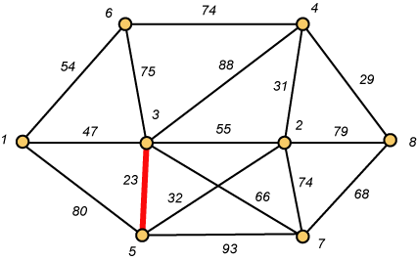
Kruskal – Step 1

Slide 48
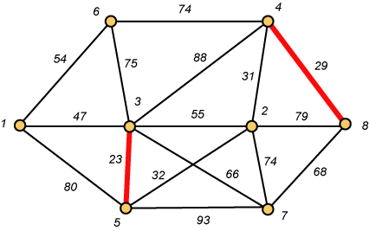
Kruskal – Step 2

Slide 49
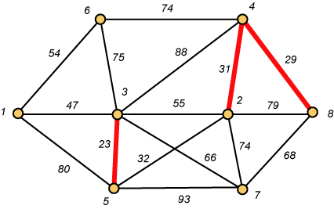
Kruskal – Step 3

Slide 50
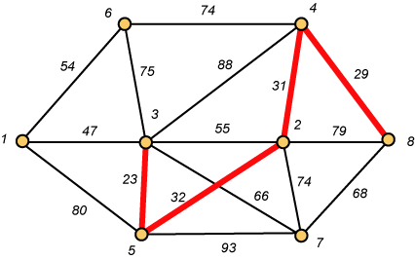
Kruskal – Step 4

Slide 51

Kruskal – Step 5

Slide 52
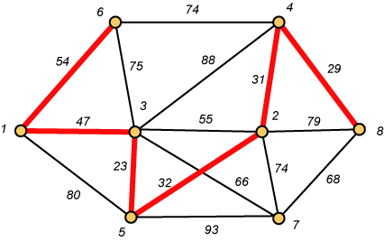
Kruskal – Step 6

Slide 53
Why Avoiding Cycles Matters
Up to this point, we have simply taken the edges in order of their weight. But now we will have to reject an edge since it forms a cycle when added to those already chosen.

Slide 54
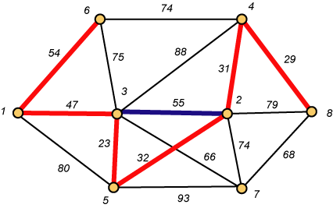
Forms a Cycle
So we cannot take the blue edge having weight 55.

Slide 55
Kruskal – Step 7 DONE!!
Weight (T) = 23 + 29 + 31 + 32 + 47 + 54 + 66 = 282

Slide 56
Disjoint-Set
Keep a collection of sets S₁, S₂, .., S_{k},
  Each S_{i} is a set, e,g, S₁={v₁, v₂, v₈}.
Three operations
  Make-Set(x)-creates a new set whose only member is x.
  Union(x, y) –unites the sets that contain x and y, say, S_{x} and S_{y}, into a new set that is the union of the two sets.
  Find-Set(x)-returns a pointer to the representative of the set containing x.

Slide 57
Kruskal's Algorithm
The algorithm adds the cheapest edge that connects two trees of the forest
MST-Kruskal(G,w)
01 A ← ∅
02 for each vertex v ∈ V[G] do
03 Make-Set(v)
04 sort the edges of E by non-decreasing weight w
05 for each edge (u,v) ∈ E, in order by non-decreasing weight do
06 if Find-Set(u) ≠ Find-Set(v) then
07 A ← A ∪ {(u,v)}
08 Union(u,v)
09 return A
O(V)
O(ElogE)
O(E)
O(V)
Overall Complexity: O(VE)

Slide 58
Topological Sort
Topological sort of a directed acyclic graph G = (V, E): a linear order of vertices such that if there exists an edge (u, v), then u appears before v in the ordering.
Directed acyclic graphs (DAGs)
  Used to represent precedence of events or processes that have a partial order
  a before b b before c
  b before c a before c
What about
a and b?
a before c
Topological sort helps us establish a total order

Slide 59
Topological Sort
Want to “sort” a directed acyclic graph (DAG).
A
B
D
C
E
A
B
C
D
E
Think of original DAG as a partial order.
Want a total order that extends this partial order.

Slide 60
Topological Sort - Application
Application 1
  in scheduling a sequence of jobs.
  The jobs are represented by vertices,
  there is an edge from x to y if job x must be completed before job y can be done
    (for example, washing machine must finish before we put the clothes to dry). Then, a topological sort gives an order in which to perform the jobs
Application 2
  In open credit system, how to take courses (in order) such that, pre-requisite of courses will not create any problem

Slide 61
Topological Sort (Fig – Cormen)
undershorts
11/
TOPOLOGICAL-SORT(V, E)
Call DFS(V, E) to compute finishing times f[v] for each vertex v
When each vertex is finished, insert it onto the front of a linked list
Return the linked list of vertices
16
17/
18
socks
15
12/
pants
shoes
13/
14
1/
shirt
8
6/
7
belt
watch
9/
10
tie
2/
5
jacket
3/
4
socks
undershorts
pants
shoes
watch
shirt
belt
tie
jacket
Running time: Θ(V + E)

